Slide 1


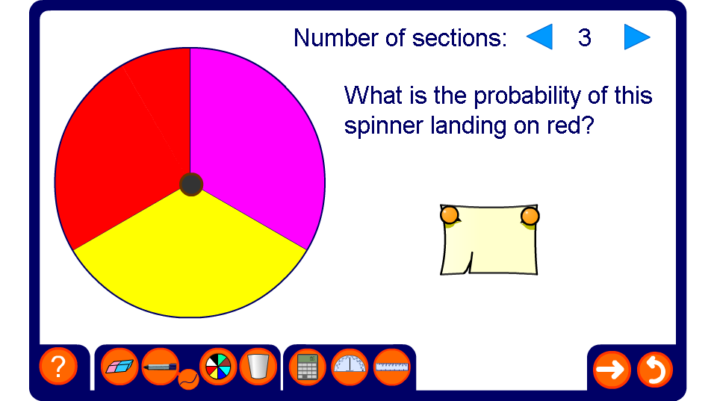


Calculating probabilities with spinners

